Slide 1
Programming 4 - Intermediate Architecture
and Algorithms
More Python
Semester 1, 2019

Slide 2
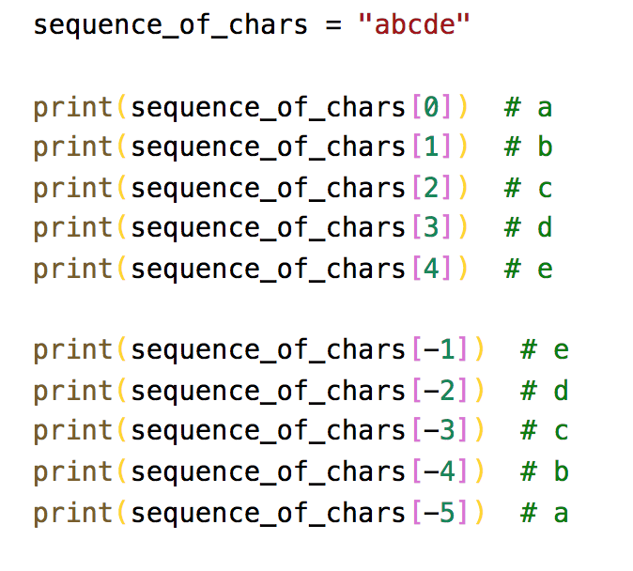
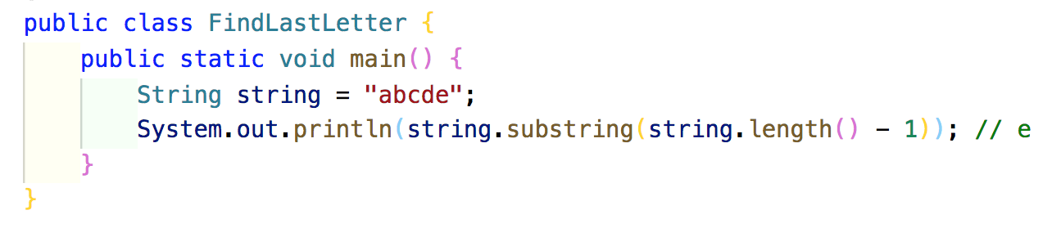
Sequences
Ordered sets
Powerful operation on sequence types
Basic indexing example:
Notes:
Ordered sets are in other languages, we just call them arrays or lists
Python has a very powerful set of special sequence data structures and operations
Slicing is a super powerful operation for array/sequence indexing
In Python, arrays don’t quite work the same as other languages like C# and Java but we are going to look at slicing on the most fundamental sequence type of all – the string
Strings are zero-indexed but we also have negative indexing to count in from the end
Strings are not zero-indexed from the end
You can easily write a program in other language to get the last character of a string but Python makes it much easier
The designer of Python decided that slicing is important that it needs to be primitive
Anyone who wants to build a Python interpreter has to build this in

Slide 3
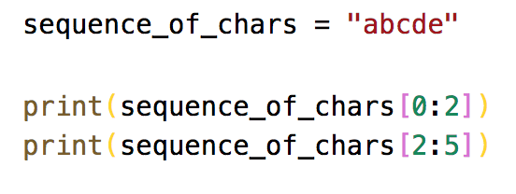
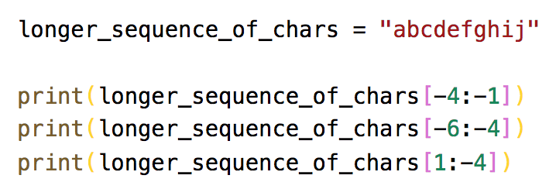
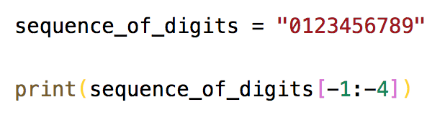
Slicing
More complex indexing option
Start is include and end is exclusive
Negative index slicing
Good for stripping strings
Check for empty strings

Slide 4
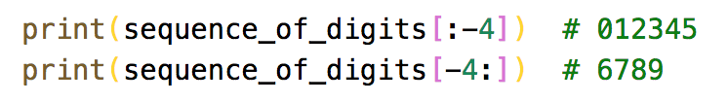
Omitting an index
Means “all”
[start:] – from start (inclusive) to the end
[:end] – from the start to the end (exclusive)

Slide 5
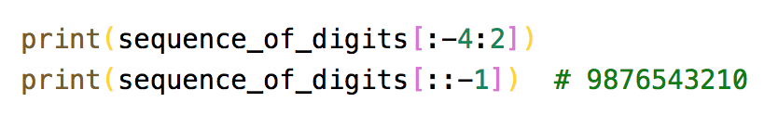
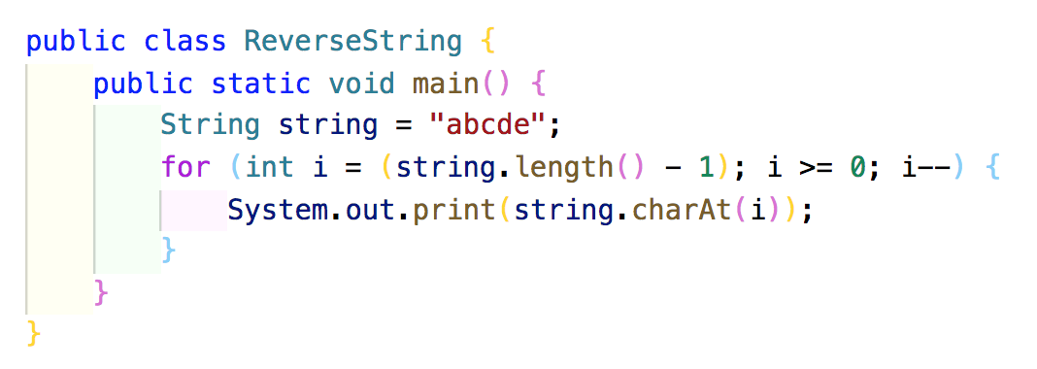
Step
Optional 3rd argument
[start:end:step]
Start and end must describe a right-to-left slice
Remember…start is inclusive and end is exclusive
Excellent way to reverse a string

Slide 6
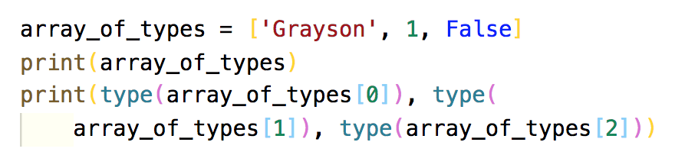
Sequence types
Lists – []
Tuples – ()
Dictionaries – {}
Lists are mutable
Tuples are immutable
Dictionaries are key: value pairs
Notes:
Lists and tuples are both ordered collections of elements
Mutable can be changed after creation
Immutable can’t be changed after creation

Slide 7
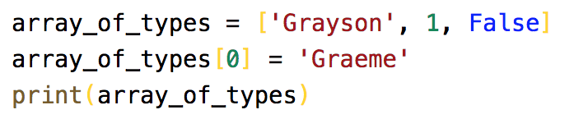
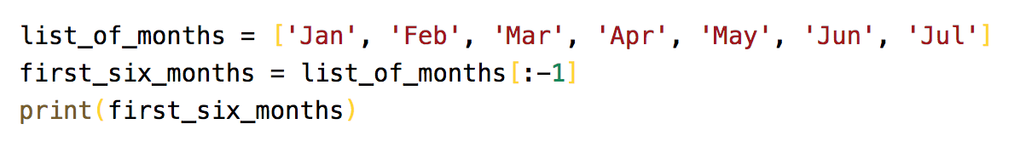
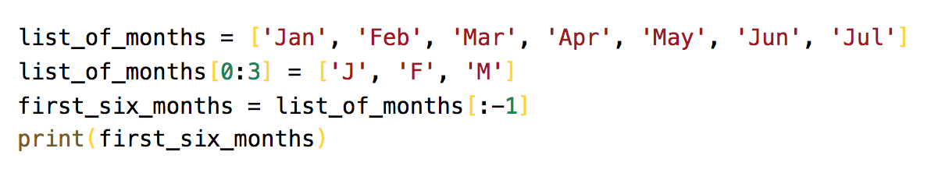
Lists
Indexed as you would expected
Like strings, you can slice on lists

Slide 8
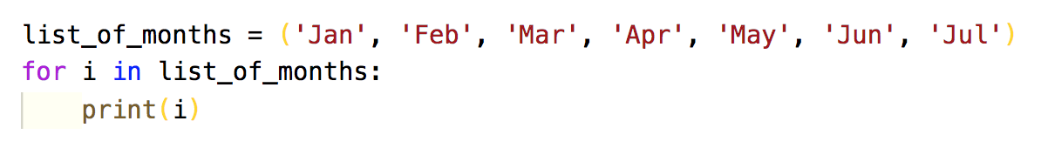
Tuples
Once declared, they can’t be changed
Used like a database record
TypeError: ‘tuple’ object does not support item assignment

Slide 9
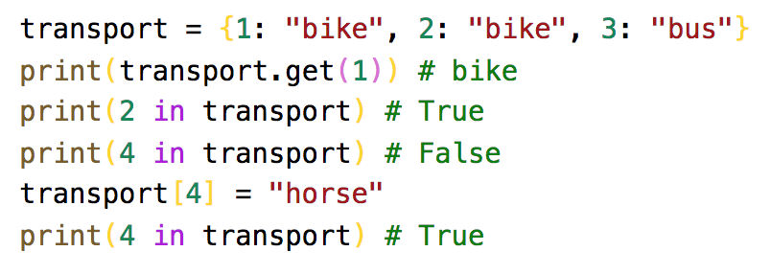
Dictionaries
All languages should have a type of dictionary
They are separated by a colon :

Slide 10
Classes
Declare with class key word
Methods are declared within the code block
All methods have self as the 1st argument
The constructor must be called __init__
Data members:
Are not pre-declared
If created outside of the class, they are static
If created inside of the class, they are local
If created inside of the method, they are prefixed with self

Slide 11
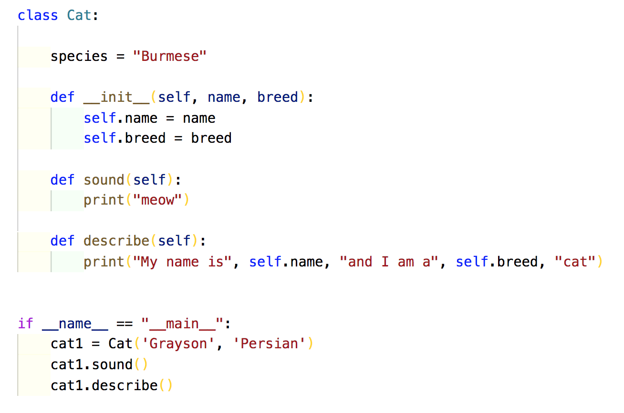
Classes

Slide 12
Ruby assignment
Due on the last day of the semester (21/06/2019)
As promised, I will run through an example

